Slide 1
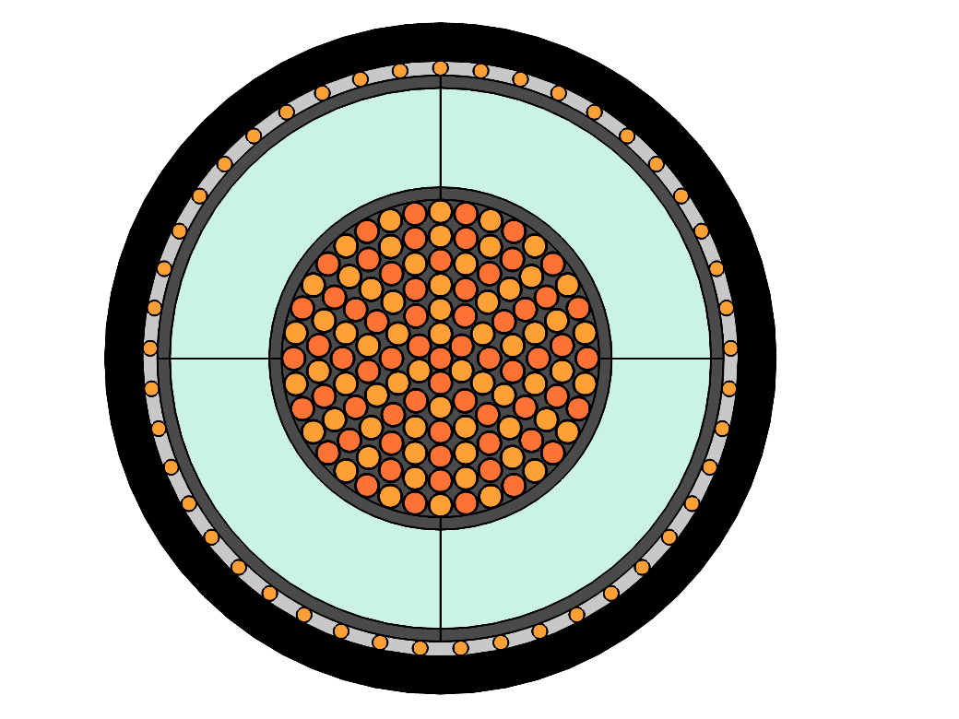
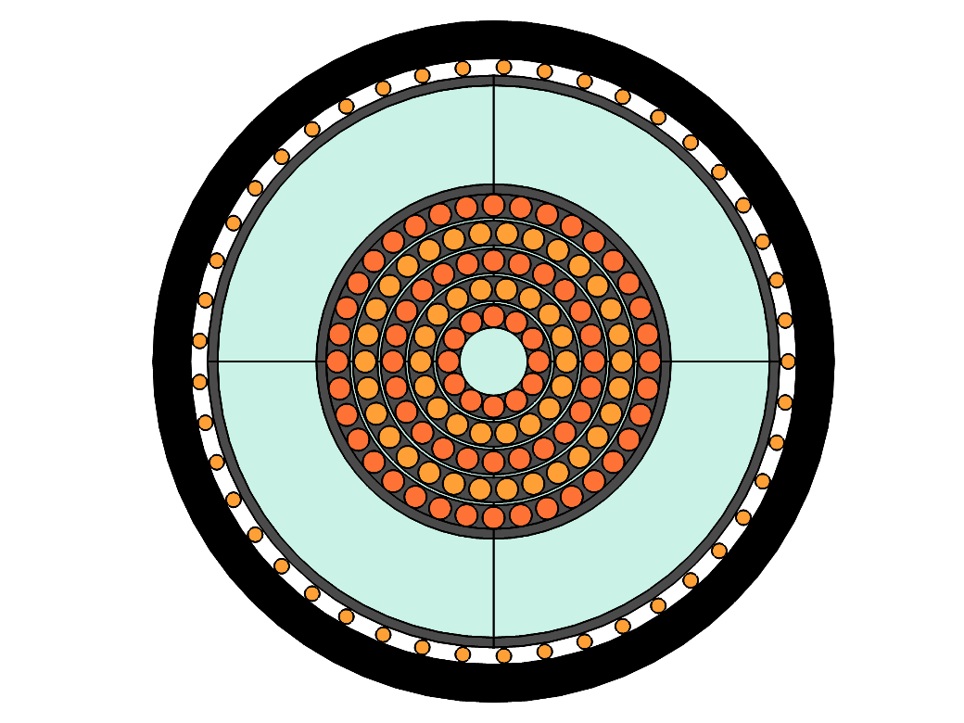
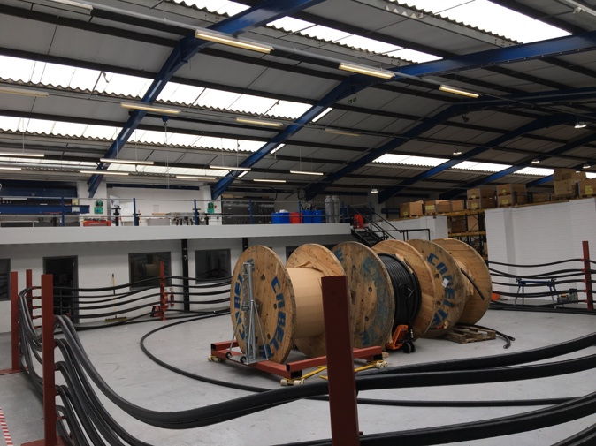
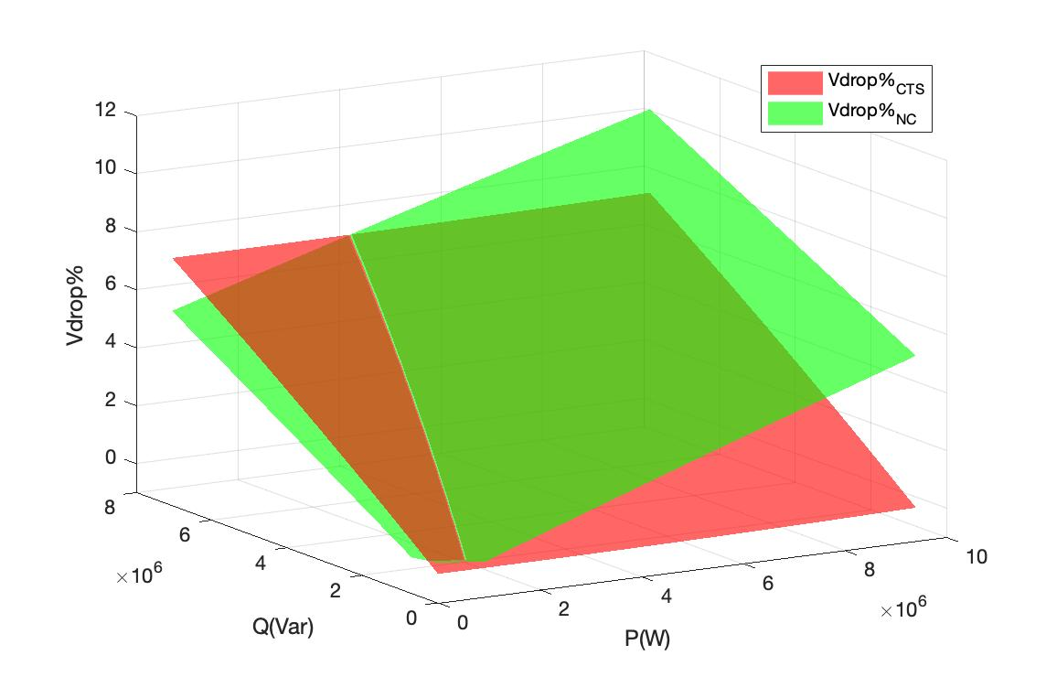
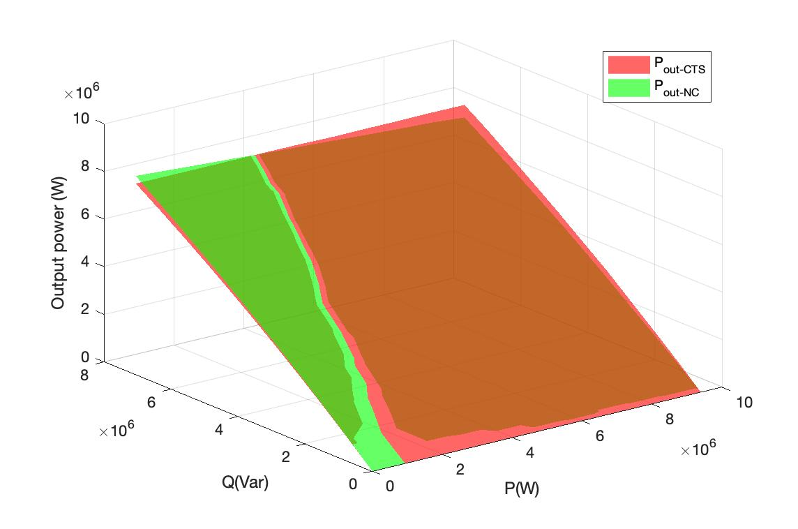
EIC 2019
Capacitive Transfer Cable and Its Performance in Comparison with Conventional Solid Insulated Cable
Yang Yang¹, Mohamed K. Darwish¹, Mansour Salehi Moghadam², Dominic Quennell², Ashkan Daria Hajiloo²
1 Brunel University London, Kington ln, London, UB8 3PH, United Kingdom
2 Enertechnos Ltd, 19 Kingsmill Business Park, Kingston, KT1 3GZ, United Kingdom
1 Introduction
In 2018, wind energy is 14% of the EU’s electricity (up from 12% in 2017). Wind power capacity rose by 11.3 GW in 2018: 8.6 GW onshore and 2.65 GW offshore. 16.7 GW of future projects reached Final Investment Decision in 2018. With the development of off-shore wind generation, more and more long-distance fluctuating power is connected to on-shore substation.
However, due to high load current flowing through the cable, there is high voltage drop at the receiving end. Due to low load current and high shunt capacitive current in the cable, there is voltage rise at the receiving end. These two issues limit the power delivery to the main electric networks.
In this case, there are several traditional methods to avoid high voltage drop or voltage rise: (1) to increase the transmission voltage level; (2) to increase the number of paralleled cables; (3) to switch off cables to avoid voltage rise when load current is low; (4) to employ high voltage direction current (HVDC); (5) to apply reactive power compensation.
However, solution (1) requires the investment of higher transmission voltage level devices and increases shunt capacitive power to ground; solution (2) multiplies the investment of transmission cables, and increases shunt capacitive power to ground; solution (3) increases the difficulty in control and the risks of switch transient impact on electric networks; solution (4) drastically increases the investment, especially for the construction of converter station; solution (5) is difficult to find suitable location and increases the investment in complex power electronic control devices.
3 Design of CTS cable
Input wire
Input wire
Output wire
Output wire
Insulation
Insulation
Metallic sheath
Metallic sheath
Enamel layer
Enamel layer
(a) Enamelled CTS model
(b) Multilayer CTS model
Figure 3. Different CTS cable design
4 Comparative experiment
(a) Reactance of CTS cable and NC
(b) Test site
Figure 4. Comparative experiments between CTS cable and NC
5 Simulation results
2 Concept of CTS
Figure 1. A single-phase CTS cable connected to an AC source and a load
2.1 Voltage drop
$$V_{drop−AC}=IZ_{AC}=I\sqrt{{R_{AC}}^{2}+{X_{L}}^{2}}$$
Figure 5. Comparison of the voltage drops and the output power of CTS & NC
$$V_{drop−CTS}=IZ_{CTS}=I\sqrt{{R_{AC}}^{2}+{X_{CTS}}^{2}}=I\sqrt{{R_{AC}}^{2}+{(X_{L}−X_{C})}^{2}}$$
6 Conclusions
Less voltage drop and more power delivery, when load current is high
No voltage rise when load current is low
Suitable for long-distance power-changing electricity transmission
2.2 Voltage rise
Dr. Yang Yang
E: yang.yang@brunel.ac.uk
T: +44 (0)1895 266755
(a) Output voltage of CTS cable
(b) Output voltage of NC
Figure 2. Voltage outputs of CTS cable and NC when load current is low

